Slide 1





Class model: Why did the fish die in Passion Puddle?
Dead Fish
Notes:
Spend 2 min reviewing the class model (this is 5B, 5A is next slide)

Slide 2

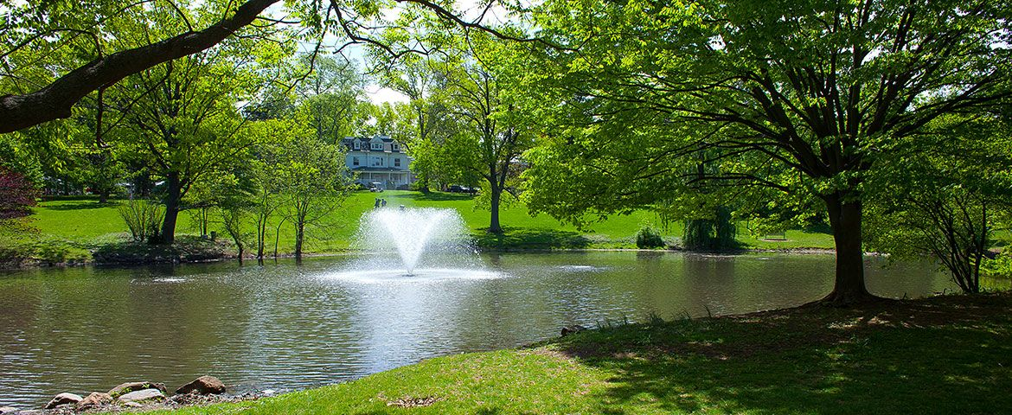
New Information!!!
Scientists at Rutgers recently found out that the fountain in Passion Pond broke and stopped working about 2 weeks before the fish died.
Notes:
Tell students that new information just came out that may be relevant.
Scientists at Rutgers found out that…. (READ text on slide)

Slide 3

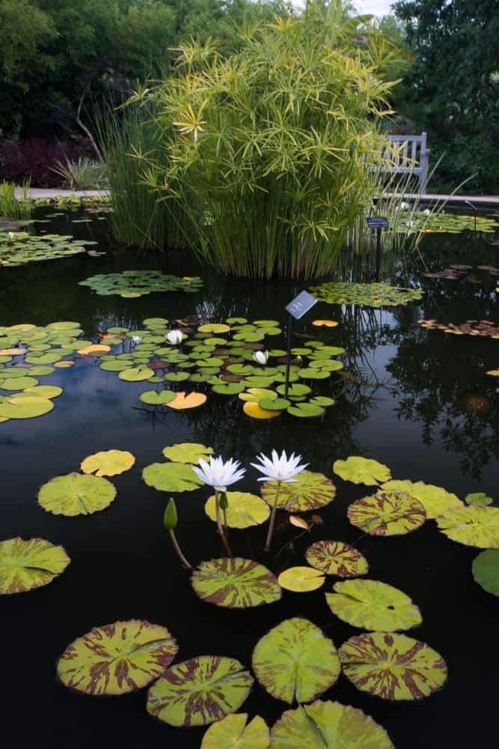
Evidence: Fountains and Ponds
The gardeners at Penn State wanted to install a new fountain in their lotus pond.
Fountains suck water from the bottom of the pond and spray it up where it mixes with air before falling back into the pond.
The gardeners first measured the dissolved air 4 feet below the surface of the pond. The dissolved air was 4 mg/l
Notes:
We are not sure if this is relevant or not, we don’t know much about fountains.
Here is some evidence about fountains.
READ evidence (this and next slide)

Slide 4
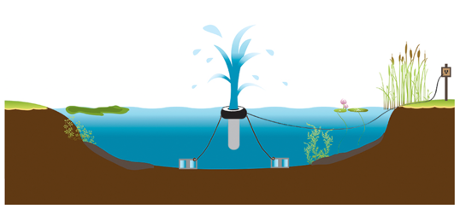
Evidence: Fountains and Ponds
The gardeners at Penn State wanted to install a new fountain in their lotus pond.
The gardeners first measured the dissolved air 4 feet below the surface of the pond. The dissolved air was 4 mg/l
They then installed a fountain in the middle of their pond.
They measured the dissolved air 4 feet below the surface after the fountain worked for 5 days. The dissolved air was 8 mg/l
Notes:
Read slide. (new information is in middle)

Slide 5
Class model:
What should you do to our class model given this new evidence? You can make changes to the class model above and explain your changes below:
Notes:
Ask them to decide what they should do to the model INDIVIDUALLY. They can change the model itself write on it AND explain their changes. This is 5B

Slide 6
Simulations, studies and models
In science you have learned a lot about criteria for good models. What do you think is the MOST important criterion for good models? Explain why you think so!
List three important differences between evidence from simulations and evidence from studies:
Notes:
Last two questions, just read and have them answer.

